Slide 1
LAURA 2.0
Sadman Jashim Sakib (110142149)
Gurpartap Singh Ahluwalia (110130540)
Bishwadeep Sikder (110132230)
Instructor:
Dr. Jianguo Lu

Slide 2
Overview
We have created a search system based on Elasticsearch which performs both phrase-match and semantic searching of academic papers based on title, authors and abstract content.
We have chosen the ArXiv dataset from Kaggle, which contains about 2.3 million academic papers with a well-defined easy-to-parse structure.
We have implemented a REST API which enables search query processing from external sources through HTTP Get calls, using Flask.
Finally we have implemented a frontend web application using Angular which consumes the Flask Web API and performs searching.

Slide 3

ArXiv Dataset
For nearly 30 years, ArXiv has served the public and research communities by providing open access to scholarly articles, from the vast branches of physics to the many subdisciplines of computer science to everything in between, including math, statistics, electrical engineering, quantitative biology, and economics.
This dataset is a mirror of the original ArXiv data. Because the full dataset is rather large (1.1TB and growing), this dataset provides only a metadata file in the json format.

Slide 4
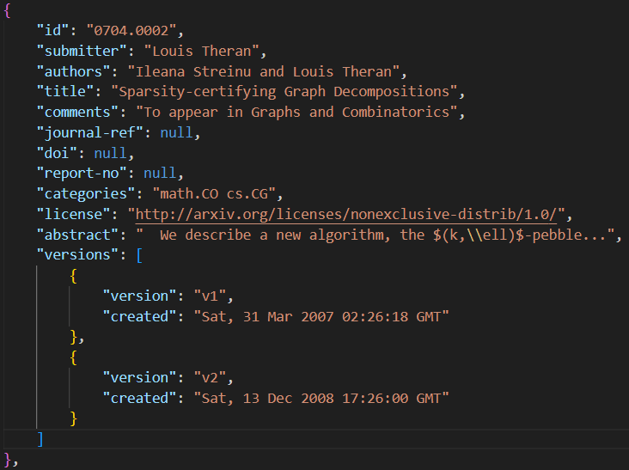
ArXiv Dataset - Data Structure and Components
id: ArXiv ID (can be used to access the paper, see below)
submitter: Who submitted the paper
authors: Authors of the paper
title: Title of the paper
comments: Additional info, such as number of pages and figures
journal-ref: Information about the journal the paper was published in
doi: [https://www.doi.org](Digital Object Identifier)
abstract: The abstract of the paper
categories: Categories / tags in the ArXiv system
versions: A version history

Slide 5
Text Embeddings
We have performed embedding on the ‘Abstract’ of each paper so that we can semantically search for papers based on the actual abstract content.
Embeddings implemented:
BERT
RoBERTA
DistilBERT
SBERT
Out of these embedding methods, we stick to SBERT since it seems to give good recommendations based on content.

Slide 6
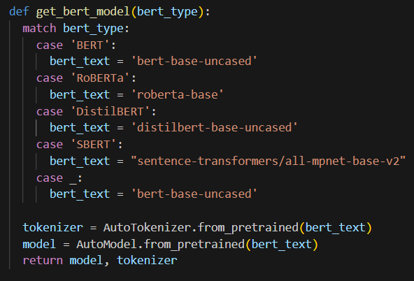
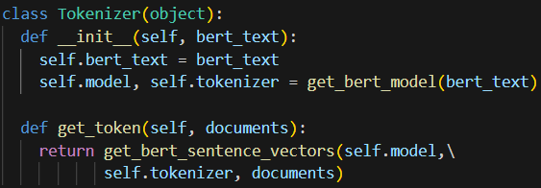

Text Embedding Code Segment
Here is our code for retrieving the BERT models and encoding the ‘Abstract’ column into vectors.

Slide 7
Elasticsearch
We have implemented Elasticsearch in Python which uses the embeddings generated previously by SBERT model, for performing semantic searching.
We create the mappings for the index which will contain the data-structure according to which the indices will be created, and output will be returned.
We create the indexing for each paper using the mappings structure in the next slide and the data as ‘records’ in the dictionary form.
We declare the ‘abstract_vector’ as a dense vector and index it using HNSW Graph.
We also perform full-text multi-match query based on the fields, ‘title’ and ‘author’.

Slide 8
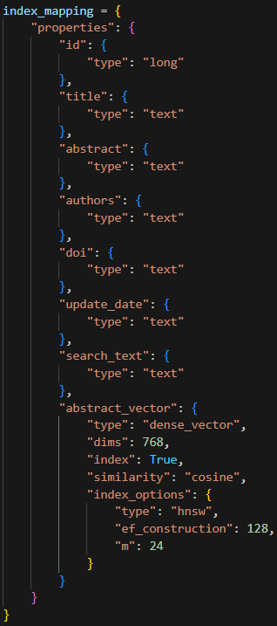
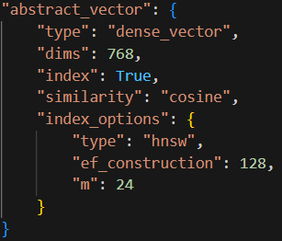
Elasticsearch Indexing
We use ‘cosine’ similarity to compare the embeddings.
We use HNSW Graph to build the indexing of embeddings with the ‘ef_construction’ and ‘m’ parameters set to 128 and 24 respectively.
The ‘ef_construction’ parameter refers to the size of the dynamic list for the nearest neighbors, which also controls the tradeoff between index construction time and accuracy.
The ‘M’ parameter defines the maximum number of outgoing connections in the graph.

Slide 9
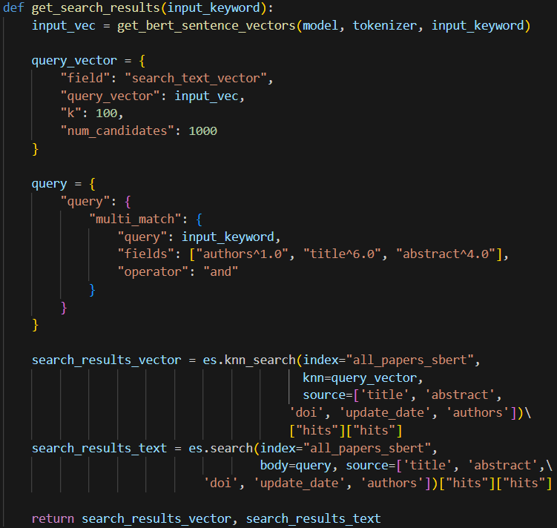
Elasticsearch Query Processing
We perform full-text query matching on ‘authors’, ‘title’ and ‘abstract’ data to look for exact matches and we give most weightage to the paper titles, then abstract content and finally on authors.
We perform semantic searching on the ‘abstract_vector’ column which contains the embeddings for the ‘abstract’ data.
Semantic search is being performed by approximate nearest neighbors algorithm, it is very fast.

Slide 10
Flask: REST API
We finally process any incoming HTTP request containing the search key and send the response containing the search results in JSON format.
We create a Web API in Flask, which is a backend framework in Python.
It listens to a port and accepts any incoming HTTP Get request containing the search key, which on arrival is passed on to the query processor.
Finally the search results are bundled into JSON format and sent back to request sender.

Slide 11
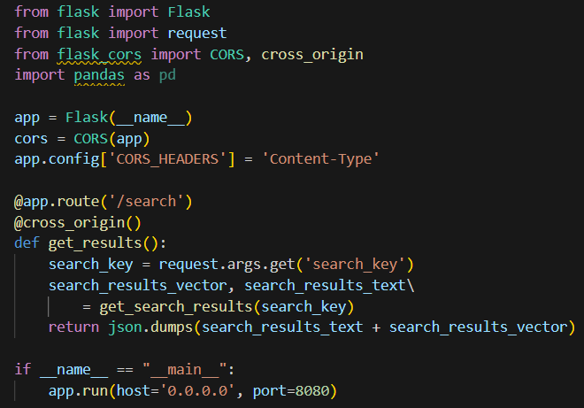
Flask: REST API Code Segment

Slide 12
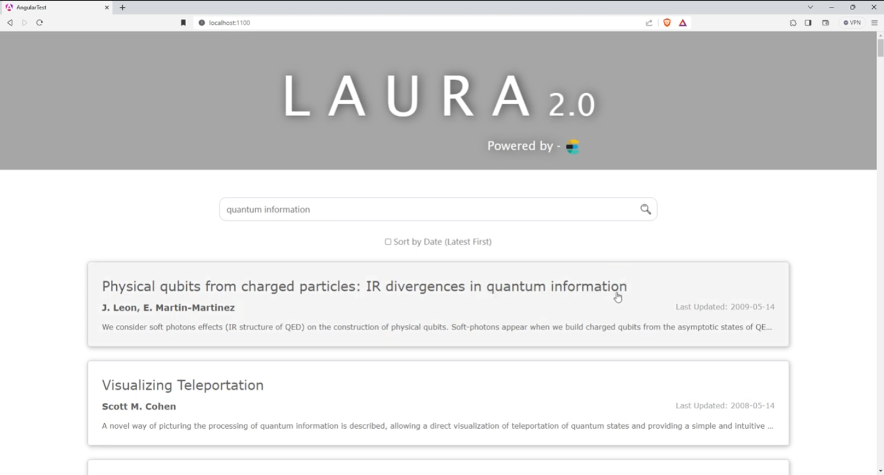
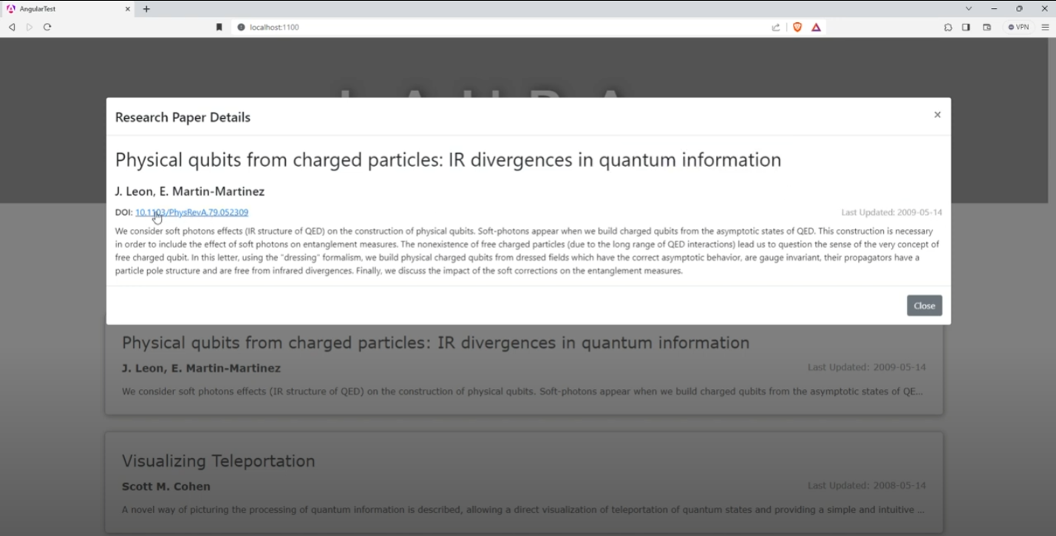
Angular: Frontend
The frontend consumer is built on Angular 14, a framework based on JavaScript which is used to develop single-page applications. It shows the search results and can also sort the results based on ‘published date’.

Slide 13
Conclusion and Future Work
Search for datasets containing citation network and information.
Perform Angle-optimized embedding algorithms, GPT embeddings and optimize the indexing scheme to handle higher dimensional vectors for faster semantic searching.
Implement full-fledged PageRank for more appropriate semantic searching.
Implement front-end features like pagination and dynamic loading.

